Slide 1



Slide 2
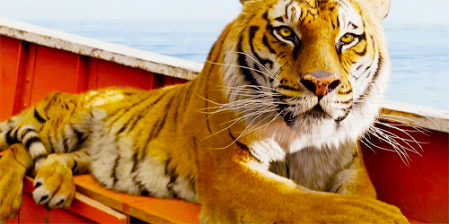
RICHARD PARKER

Slide 3
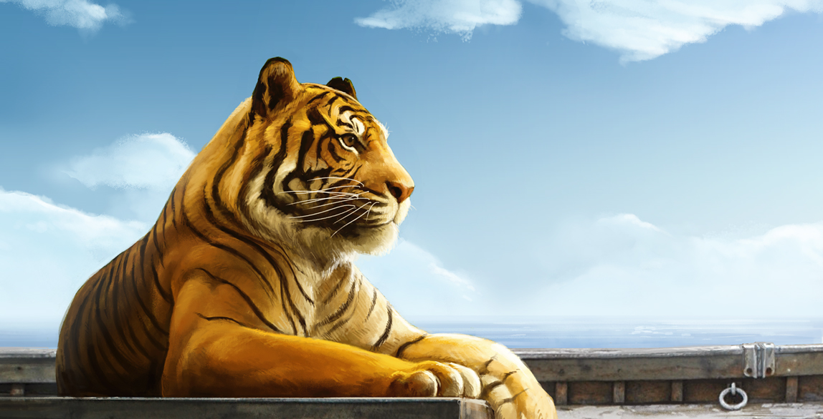
Who contributed ?
Ronik Shah
Vikas Sharma
Vikas Swarnkar
Sourabh Thakur
Shubash Kumar

Slide 4
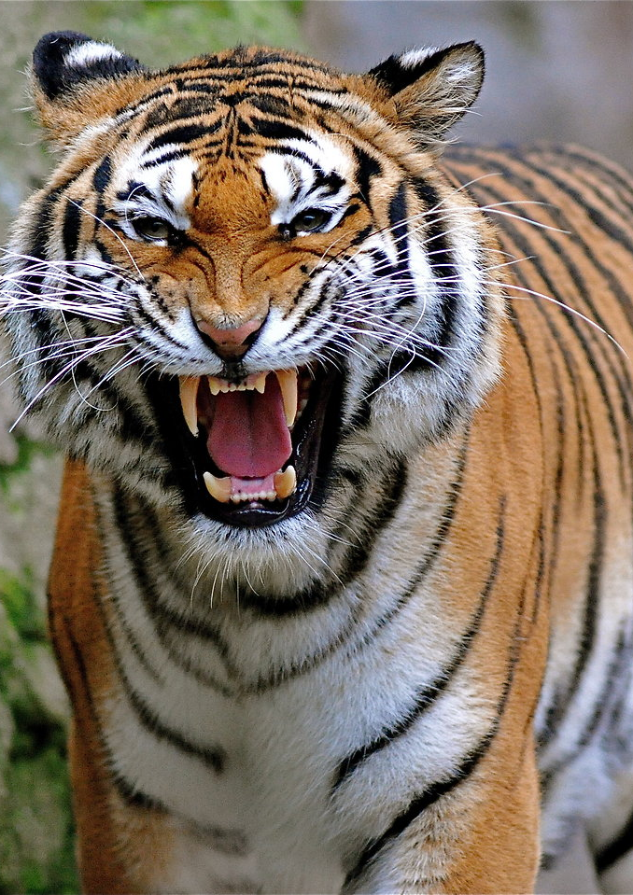
Introduction:-
Richard Parker is a royal Bengal tiger who is stranded on the lifeboat with Pi when the ship sinks. Richard Parker lives on the lifeboat with Pi and is kept alive with the food and water Pi delivers.

Slide 5
Why Name Richard Parker?
Richard Parker was the name of the Hunter , was hired to kill a panther.
Accidently, he immobilizes a female Bengal Tiger with tranquilizer darts while her cub escapes.
Parker named this cub thirsty..
But in records in Pondicherry, the names where exchanged and the family thought the movie amusing and so called his name.

Slide 6


RICHARD PARKER IS GOD
Pissing Patel had love as well as fear of Richard Parker; just like a devotee towards the god
Richard Parker, when angry, spends time in hiding and being quiet…..instead of attacking him.
Richard Parker was always with him in good and bad times……just like god..

Slide 7


RICHARD PARKER IS SURVIVAL
At first Richard Parker made PI concentrated on his work, because on seeing Richard Parker, he became attentive.
On seeing Richard Parker, PI also started eating Non-Veg though he was vegetarian….useful for his survival

Slide 8
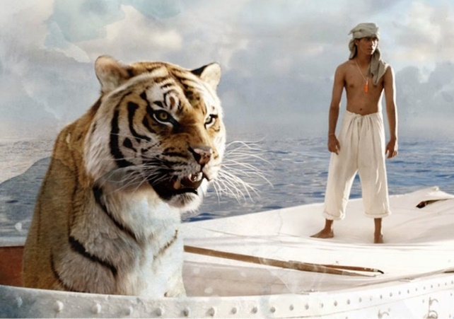
Relationship between Richard parker and pi
Richard Parker depends on PI to feed him by catching fish, while PI’s will to live his is bolstered by Richard Parker’s pressure.
Richard Parker attacks and kills the intruder, saving PI
PI begins to see the journey as a hardship he has endured with Richard Parker, however, once he is able to reach land, Richard Parker leaves without looking at him and saying goodbye.

Slide 9


Thank You

